Slide 1
Emerging Threats to Infrastructure
Jorge Orchilles
Security Analyst
South Florida ISSA
Notes:
Titled Emerging Threats to Infrastructure and NOT Advanced Persistent Threat. APT will be highlighted but by definition only refer to attacks coming from China.
Prepared for Jacksonville ISACA.

Slide 2
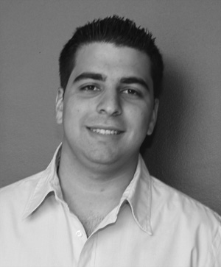
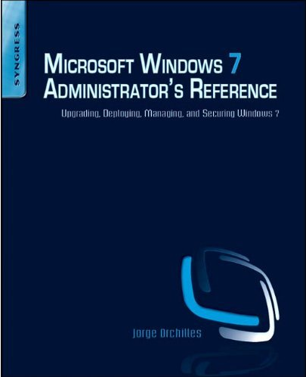
About Your Speaker
Information Technology for over 7 years
Technical Security Analyst – Fortune 20
Ex- Security Operations Center Analyst – Terremark
Consultant by night – Orchilles Consulting
MS in MIS and BBA in MIS – FIU
Author – Microsoft Windows 7 Administrator’s Reference (Syngress)
Certifications – GCIH, CEH, CCDA, CSSDS, MCTS, MCP, Security+
Organizations:
VP of South Florida ISSA
Hack Miami
OWASP
InfraGard
Miami Electronic Crimes Task Force
Notes:
Jorge Orchilles, author of Microsoft Windows 7 Administrator’s Reference, holds a Master’s of Science in Management Information Systems from Florida International University, is currently a Security Operating Center Analyst at a leading global provider of IT infrastructure services based in Miami, FL, USA and VP of Communication and Public Relations for the South Florida ISSA Chapter. Views expressed in this blog are his own.
Jorge Orchilles has been involved in the Information Technology field since 2001. He began his career as a network and system administrator for a small private high school in Orlando, FL, USA. Realizing his passion for IT, he founded The Business Strategy Partners - IT Consultants branch in 2002. Here he began serving residential and small business clients in the South Florida area as an IT Consultant. While gaining work experience, he was a very involved, full-time student in Florida International University. He founded the FIU MIS Club and continues to be a contributor to the club. While at FIU he was contracted to work on the University's Active Directory Migration Project. After completing the project he decided to move to a corporate environment to continue gaining knowledge and experience of the IT field. After two years of corporate IT he developed a large interest in Information Security and has chosen to move in that direction. He currently holds a position as a Security Operating Center analyst and is involved in various organizations in the South Florida area.
Jorge Orchilles is the author of Microsoft Windows 7 Administrator’s Reference published by Syngress. He holds a Master's of Science in Management Information Systems from Florida International University having finished third in his class with a 3.9 GPA. He also holds a Bachelor of Business Administration in Management Information Systems from Florida International University. Jorge holds various certifications from Cisco, Microsoft, and CompTIA: Cisco Certified Design Associate (CCDA), Cisco Security Solutions for System Engineers (SSSE), CompTIA Security+ (2008), Microsoft Certified Professional (70-228, 70-282, 70-284) and Microsoft Certified Technology Specialist (70-620).
Jorge speaks English, Spanish, and Portuguese in decreasing order of fluency. For more about Jorge A. Orchilles please visit his LinkedIn page.

Slide 3



Industry Reports
Microsoft Security Intelligence Report Vol. 8
Symantec State of Security Report – 2010
SANS Top Cyber Security Threats – September 2009
Verizon Business 2009 Data Breach Study – April 2009
US Cert
SANS Internet Storm Center – http://isc.sans.org/
Notes:
Information Security reports are released at different intervals throughout the year depending on the sponsor. Generally these reports are by vendors and show their results. The favored reports are those by vendor neutral entities such as the SANS, US Cert, and Verizon business which deal with actual data breaches:
Verizon: http://newscenter.verizon.com/press-releases/verizon/2009/verizon-business-2009-data.html
SANS Top Security Risk: http://www.sans.org/top-cyber-security-risks/
SANS Internet Storm Center: http://isc.sans.org/
Symantec State of Security Report - http://www.symantec.com/about/news/resources/press_kits/detail.jsp?pkid=sesreport2010
US Cert - http://www.us-cert.gov/

Slide 4
News and Media
Resources:
Data Loss Database - http://datalossdb.org/
PrivacyRights.org
Some that were reported:
Heartland Payment Systems (130+ million – 1/2009)
Oklahoma Dept of Human Service (1 million – 4/2009)
University of California (160,000 – 5/2009)
Network Solutions (573,000 – 7/2009)
U.S. Military Veterans Administration (76 million – 10/2009)
BlueCross BlueShield of Tennessee (187,000 – 10/2009)
Google (1/2010)
Many others?
Notes:
DataLossDB is a research project aimed at documenting known and reported data loss incidents and data breaches world-wide.
PrivacyRights.org - A nonprofit consumer education and advocacy project whose purpose is to advocate for consumers' privacy rights in public policy proceedings.

Slide 5

Agenda
Know your enemy
Who is your enemy?
What are they after?
How are they attacking?
Know yourself
What are you defending?
Who are you defending?
How do we defend?
It is said that if you know your enemies and know yourself, you will not be imperiled in a hundred battles; if you do not know your enemies but do know yourself, you will win one and lose one; if you do not know your enemies nor yourself, you will be imperiled in every single battle. – Sun Tzu
Notes:
Sun Tzu:
It is said that if you know your enemies and know yourself, you will not be imperiled in a hundred battles; if you do not know your enemies but do know yourself, you will win one and lose one; if you do not know your enemies nor yourself, you will be imperiled in every single battle.
Art of War for Security Managers: http://www.elsevier.com/wps/find/bookdescription.cws_home/712202/description#description
To properly analyze emerging threats we need to answer a few questions:
Who is attacking? Know your enemy
Know what your enemy is after.
Know how your enemy is attacking.

Slide 6
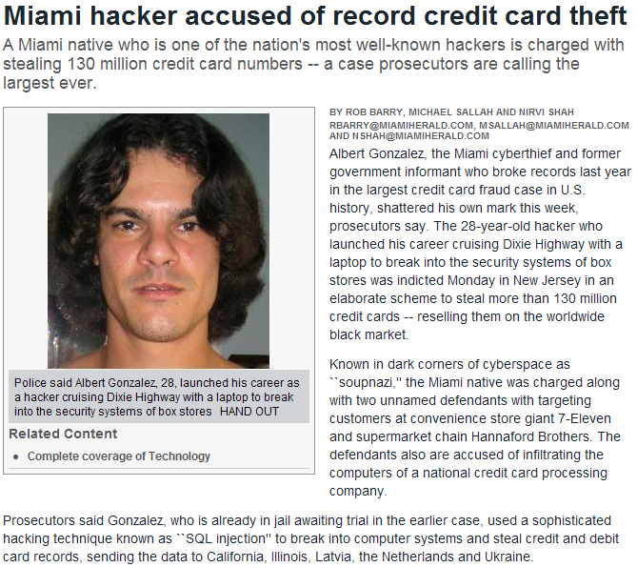

Who is attacking?
Organized Crime
Well Meaning Insider
Malicious Insider
Script Kiddies
Notes:
Organized Crime - 90% of records lost in 2008 involved organized crime targeting corporate information according to Symantec
Well Meaning Insiders – includes laptops and USB flash drives lost with data
Malicious Insiders –
Script Kiddies and automated attacks is the majority of the attacks your IDS and Anti-virus will see and stop

Slide 7
Attacker Motivation (botnets)
Vandalism and publicity
“Hacktivism”
Financially motivated
Attack
Risk
Kracken
(Botnet)
2008
July 2009
Cyber Attacks
US & Korea
Srizbi
(Botnet)
2007
Rustock
(Botnet)
2007
CodeRed
(Defacing IIS web servers)
2001
Storm
(Botnet)
2007
Blaster
(Attacking Microsoft web site)
2003
Nimda
(Installed Trojan)
2001
Estonia’s Web Sites
DoS
2007
Slammer
(Attacking SQL websites)
2003
Agobot
(DoS Botnet)
Republican
website DoS
2004
Georgia Web sites
DoS
2008
2001
2005
2009
Notes:
Botnet attacks show a lot about hacker motivation. Back in the early 2000’s it was more for vandalism, publicity, and hacktivism. In the late 2000’s a trend began to financially motivated attacks. “If my competition is down for 1 day, I get all their business”

Slide 8
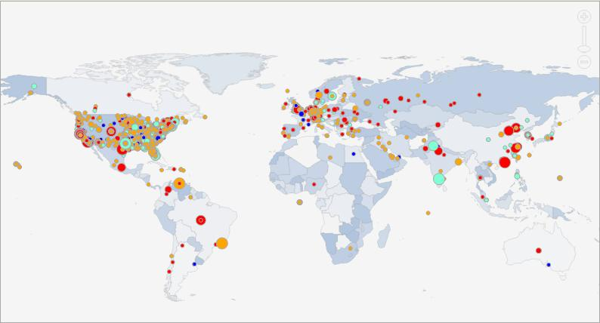
From where are they attacking?
Notes:
Where the attacks are coming from? Everywhere! Attackers generally do not attack from home, they proxy and bounce from compromised host to compromised host to hide identity.
This is a snapshot of the events in the past 24 hours as of Tuesday March 16, 2010

Slide 9
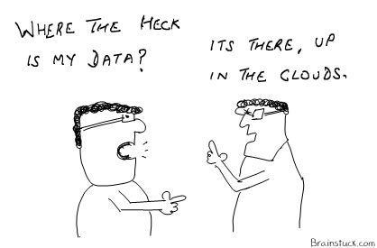
What are they after? What are you defending?
Notes:
Is anyone evaluating or looking at Cloud Computing? What is one of the main questions when considering this move? Where is my data?
Data is what they attackers of after, whether it is PII, credit card numbers, databases, etc they are after the data. Hacktivism might be after infrastructure to take it down but the biggest concern is loosing data.

Slide 10
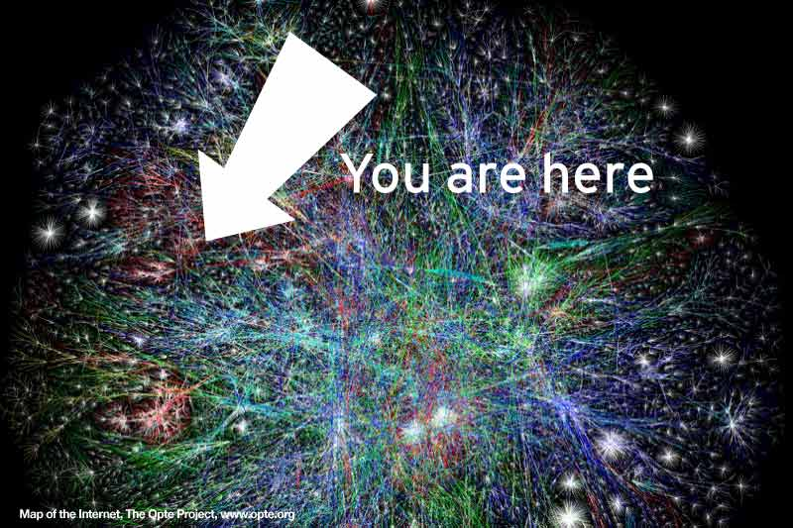
Know yourself
Users
They are going to click on EVERYTHING
On a mission to explore the entire Internet.
The Internet is so massively big and EVIL!
Security is not a major concern
They never get in trouble
“It was just a pop-up”
They “think” they know when they are being attacked
Notes:
The weakest link in any security assessment is the user. The user can be socially engineered to do things they shouldn’t, click on things they shouldn’t and eventually give an attacker access to data that they should not have.
A snapshot of a map of the internet. It is HUGE and many areas are evil!

Slide 11
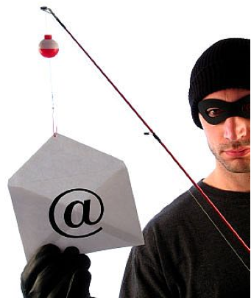
Anatomy of an Attack
Reconnaissance
Social Networks
Job Postings
Scanning
Targeted against users
Spear Phishing
Spam
Social Networks
Exploiting – initial intrusion into network
Maintaining Access
Establish backdoor – outbound connection
Obtain user credentials
Install various malware
Privilege escalation/ Lateral Movement/ Data Exfiltration
Erase tracks
Notes:
This is how attacks work and have always worked. The methods used within each point is what changes. The SANS SEC504 class that prepares you for the GIAC Certified Incident Handler certification titled Hacker Techniques, Exploits, and Incident Response is based on these main points.
The main method stays the same, the ways of doing each aspect is what changes and emerges and what we will focus on in this presentation.

Slide 12
How are they attacking?
Application vulnerabilities exceed OS vulnerabilities
Adobe Reader 0 days
Adobe Flash 0 days
Apple QuickTime
Microsoft Office
Growing Malware
Notes:
Microsoft and other Operating Systems have been diligent about releasing secure code and patches to vulnerabilities in a timely fashion. Users and IT have also been keeping up to date and patching these systems on a regular basis. Therefore, the weakest link becomes the third party applications installed on these systems. Adobe has been extremely bad about patching their vulnerable software and has horrible coding practice with what is speculated to be no concern for security. The same is true for other third party applications and developers.

Slide 13
How are they attacking?
Targeting the weakest links
Infrastructure
Applications
Users
Exploits
Serve custom malware based on Windows OS version, browser version, patch level, vulnerable third party apps
Fires exploits simultaneously at IE, Firefox, Adobe, WinZip, Java, QuickTime, ActiveX… until exploit hits target
Payload
Trojans
Bots
Etc
Notes:
Attackers today are cyber-criminals looking to make money off of your data. Attackers no longer target the OS. They are after applications that contain data that can be used to make money! Threats come from many vectors: physical vectors (floppy disk, USB drives, CD’s), Email vectors (spam, web redirection, phishing), Web vectors (drive-by downloads, malicious sites, liability). And they are targeting WEB sites as the weakest links.
The primary web vulnerabilities, SQL Injections and Cross-site Scripting (XSS) make up 80% of the exploited vulnerabilities. Because of these, your web site could be launching malware, serving malicious content to vulnerable client side applications. If it’s poorly configured to keep hackers out, hackers will plant malicious code that proliferates malware to unsuspecting surfers. Not only will your users be hurt but Google will see it and block your website until you clean it, resulting in damage to your business. Vulnerable databases that hold user data can also be hacked. Software that creates a website, like Drupal, WordPress (the most insecure), and others. Your website is vulnerable because of these platforms. Must keep systems updated and patched.
Obfuscated (hidden, obscure) Javascript, hidden in a legitimate website, redirects users connections to another server (in Astonia, Russia). This happens in background without your knowledge. You are fingerprinted, shows apps, OS, patch levels, etc., and an exploit is triggered to target a found vulnerability.
A backdoor trojan is loaded which gives the hacker access to put other things on your system, i.e., banker Trojans (programed with list of 100 banks – when you go to your bank the Trojan kicks in because it’s on the list and it captures your info and uploads it to a remote server.

Slide 14
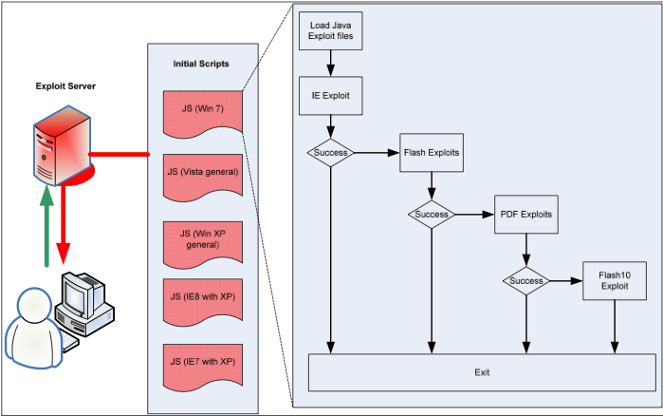

Slide 15
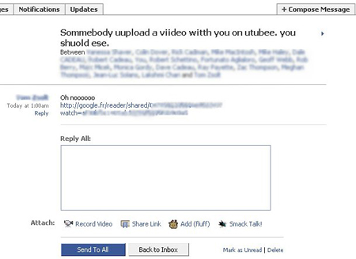
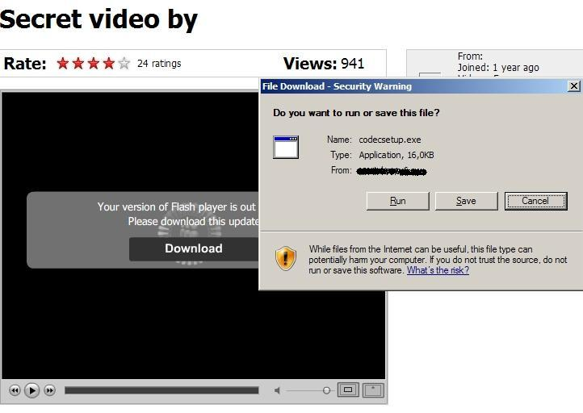
Facebook Attack In Action
Net-Worm.Win32.Koobface
Created in July 2008
Variants still squirming in 2009
Net-worm that exploits trust on Facebook and Myspace
Notes:
Koobface. A network worm running on Windows systems. There are 60 new variants today since july 2008.
Originally found on facebook but now it’s occurring on twitter and myspace. Exploits this trusted site kind of thing.
Here’s what it looks like. Notice the redirector says google to add more trust.
You click on the link and it looks like Youtube. Then it tells you that you need to update your flashplayer. If you run it, you get the malware. When you get it, you then start sending the same message to all of your friends and family. Makes you very popular!!

Slide 16
Windows Help and Support Center
Vulnerability in Windows Help and Support Center Could Allow Remote Code Execution
CVE-2010-1885
Microsoft is investigating new public reports of a possible vulnerability in the Windows Help and Support Center function that is delivered with supported editions of Windows XP and Windows Server 2003. This vulnerability could allow remote code execution if a user views a specially crafted Web page using a Web browser or clicks a specially crafted link in an e-mail message.
This is a serious issue that could result in arbitrary code execution on a victims machines. The fact that any browser that can handle the HCP web protocol is potentially vulnerable means that users cannot simply switch to a different browser in order to be secure. Users are advised to be extra vigilant when browsing the internet and to treat any links received in email messages with extreme caution.
First sample seen 15th June 2010
Discovery date 10th June 2010
No patch is currently available but users are advised to apply Microsoft's suggested workaround for disabling support for the HCP protocol.
Affected software
Windows XP Service Pack 2 and Windows XP Service Pack 3 with IE 7 or IE 8
Windows XP Professional x64 Edition Service Pack 2
Windows Server 2003 Service Pack 2
References
http://www.microsoft.com/technet/security/advisory/2219475.mspx
http://www.cve.mitre.org/cgi-bin/cvename.cgi?name=CVE-2010-1885

Slide 17
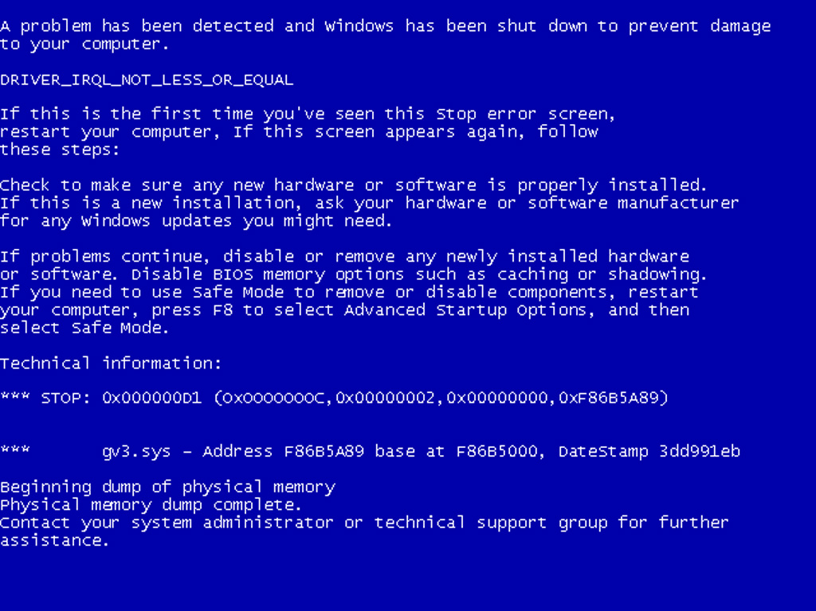

Slide 18
How do we let this happening?
Lack of user awareness
Poorly protected infrastructure
Patch everything, not just OS but applications
Poorly protected data
Poorly enforced IT/Security Policy
Security tools deployed don’t just work

Slide 19
How do we fix this?
Are you willing to be proactive about security?
Ask these 5 key questions:
What data is being collected, transacted on, transmitted, or stored, and for what purpose?
How are authentication and authorization being accomplished?
What are the communications channels between each component of the system and do they cross any network boundaries?
Does the solution involve: an Application Service Provider, data in the Cloud, an externally facing service?
Are there any regulatory laws, statutes, and/or compliance that must be met?

Slide 20
You can make a difference!
Think architecturally about security
Follow Project Life Cycle process
Ask the 5 key questions on all projects
Ensure implementation of requirements
Grow your security knowledge
Evangelize information security in your area

Slide 21
Conclusion
You will get compromised!
Plan accordingly – incident response planning
Focus on securing the data and the access to it
Secure the user environment
Patch OS AND applications
User awareness training
Not just a form to sign
Test the users!
Stay current with latest infosec news!

Slide 22

Questions?
Jorge Orchilles
jorge@orchilles.com
Twitter: jorgeorchilles
http://www.orchilles.com
Podcast: SMBMinute.com

Slide 23
Straight from Microsoft SIR
Windows 7 and Windows Vista+SP2 have the lowest infection rates of any platform for the data collected in the SIR.
The 64-bit versions of Windows 7 and Vista+SP2 had lower infection rates than any other operating system configuration in 2H09, although the 32-bit versions both had infection rates that were less than half of Windows XP with its most up-to-date service pack, SP3.
Domain-joined computers were much more likely to encounter worms than non-domain computers, and Conficker is by far the most widespread worm in Active Directory environment.
Application vulnerabilities continued to account for most vulnerabilities in 2009.
56.2 percent of the Microsoft Office attacks affected programs that had not been updated since 2003
44.1 percent of browser-based exploits in 2H09 were related to Adobe Reader.

Slide 24
Growing Malware Threat
New threats per day: ~30,000
New signatures per day:
~3,500
Total as of September 1, 2009: 2,739,919
Signature based Anti-Virus and IDS will not catch it all!
Notes:
Malware is an increasing threat. Over 30,000 new malware variants are released per day. In this presentation we will create 1 more for the purpose of proving this point. The malware will not leave the sandbox/demo environment.
Anti-virus vendors cannot keep up with the growing threat. The growth is incredible.

Slide 25
What is Advanced Persistent Threat?
Term coined by U.S. Air Force for Chinese Related Intrusions
Attacks conducted by well funded and organized groups
Professionals not script kiddies!
Motivation
Economic, Financial, and Political against US government and commercial entities
Targeted attacks
Custom Malware
Constant Aggressor
Network Occupation
Persistent Access to network
This is not new! Over 5 years seeing this activity!

Slide 26
Why is APT Successful?
Victims and targets are not aware of these attacks
Good that Google disclosed?
Information Security Defenses Don’t Work!
APT evades:
Anti-Virus signatures
IDS signatures
Network appliances (firewall, IPS, etc)
Security Operations?
APT remains undetected once inside the network!

Slide 27
Case Study: Heartland
They were PCI Compliant!
~ 130 million credit cards compromised
Notified by 3rd party!
Attackers had persistent long-term access
Possible initial entrance through WEP or even open Wireless Access Point.
Used targeted (custom) malware to propagate
They were PCI Compliant!!
Why was the only “early indicator” the resulting fraud? -Anton Chuvakin

Slide 28
Compliance ≠ Security
Blame TrustWave?
No way! Not fair to TrustWave!
Was compliance or PCI designed to make systems secure?
Is that even possible?
Although Compliance is not Security are more companies more secure now because of compliance?
Is this even a compliance issue?

Slide 29
Tips for Computer use at Home
Separate computer for online banking
Separate compute for the kids
Set strong administrator passwords
Use a second limited user account
Turn the computer off when not using it
Apply operating system AND application patches
Don’t use wireless for online banking
Use a strong password for online banking accounts and do not use this password ANYWHERE else

